Slide 1



WEB SERVICES TECHNOLOGIES [COMP4381]
Project Final Presentation
PALScan document scanning service for cultural heritage protection
Prepared by Team 3 :
Nagham Jawabra 1150309
Israa Hamed 1153216
2018

Slide 2
Motivation
What is the problem domain ?
Our Problem domain is Archiving and Crowdsourcing data collecting
What is the specific SOA-based solution ?
IT-motivated solution for cultural protection that enables people themselves to document and preserve cultural documents, photos, audio, etc …
Why use service computing?
Cheaper solution,because the already used tools in the archiving process is very expensive. Reusability because we will use it in our grad project, and Availability.

Slide 3


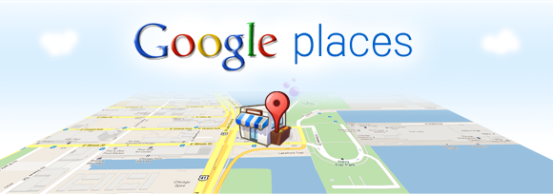
Scenario
Users can use PALScan Api functionalities provided by Web service APIs
Image location will be passed to palscan from google places
User send a request (with Metadata of the filtered and scanned image) for PALScan API.
Photos scanned and edited will be sent from PalScan service to
google cloud datastore.

Slide 4



SOA Diagram
We have Composite Service Called : Pal scan Service
We use Different Atomic services which are : Google places , scan service , filter service, Google cloud datastore
Provider is Google
Our Implementation paradigm is RestFul API
Data representation is JSON.
We use Spring Boot to implement our Services

Slide 5
SOA Diagram

Slide 6
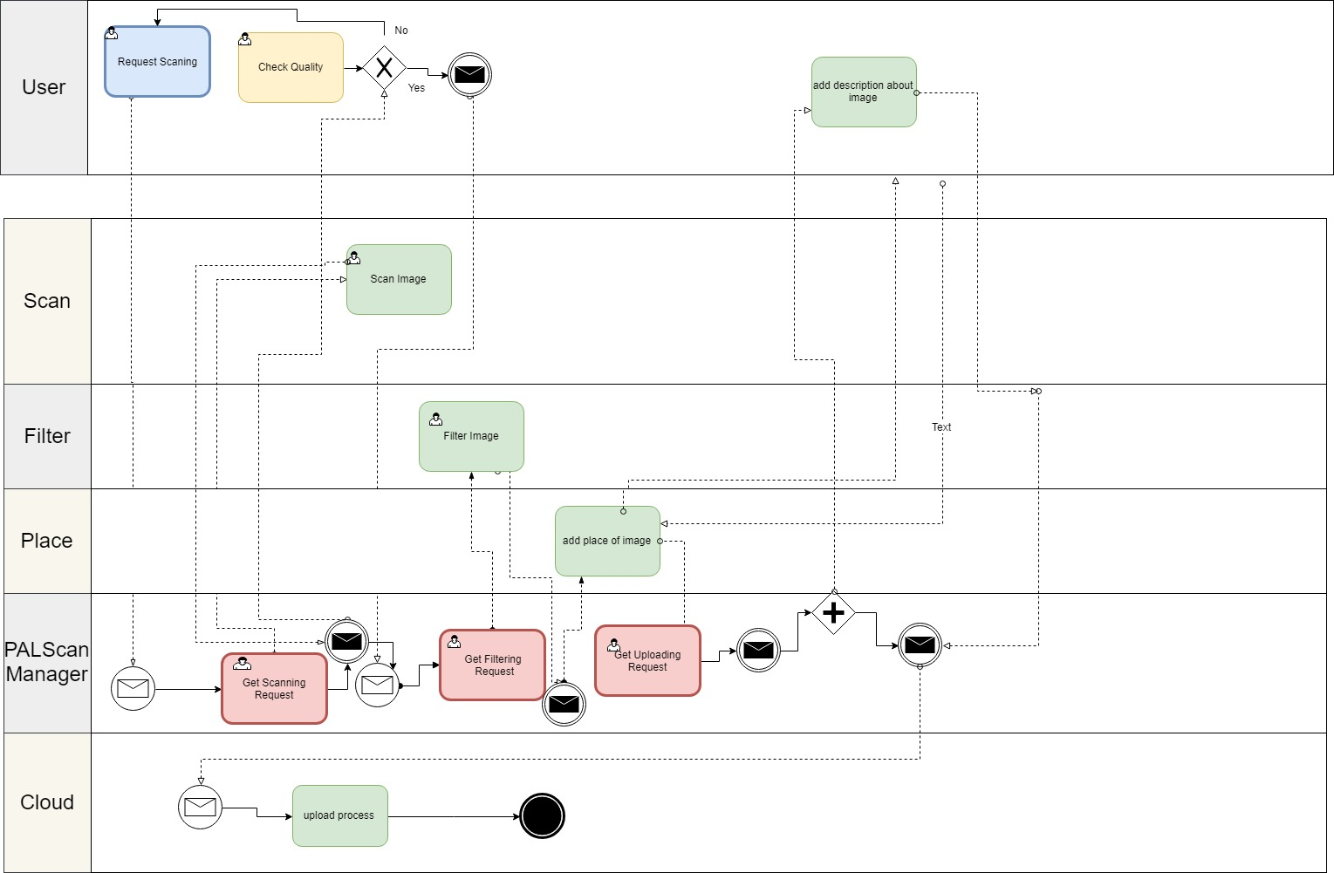
BPMN 2.0

Slide 7
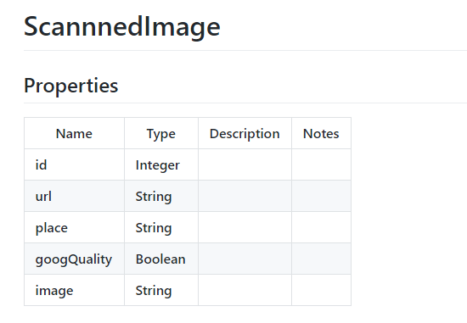
Models

Slide 8
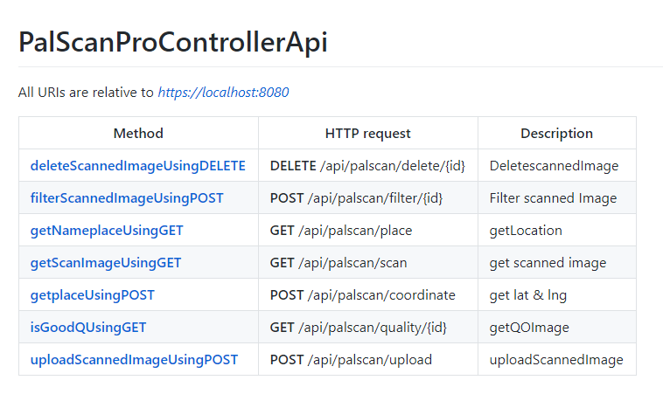
Documentation for API Endpoints
Composite controller documentation

Slide 9
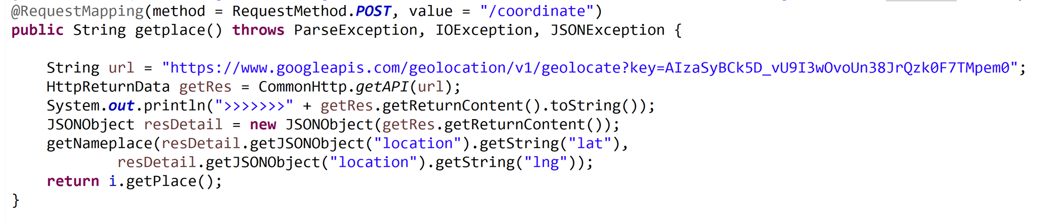
Documentation for API Endpoints

Slide 10
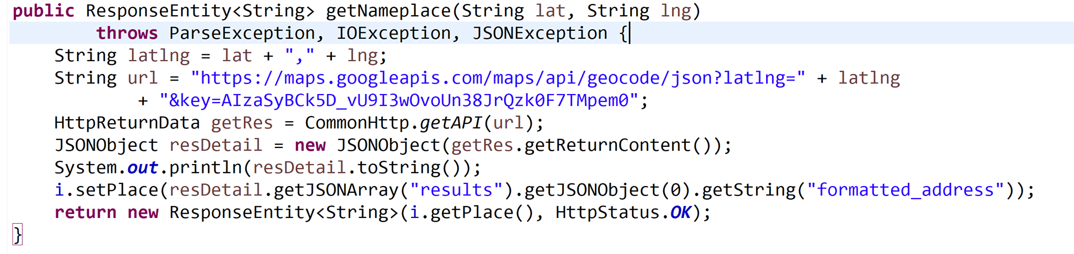
Documentation for API Endpoints

Slide 11
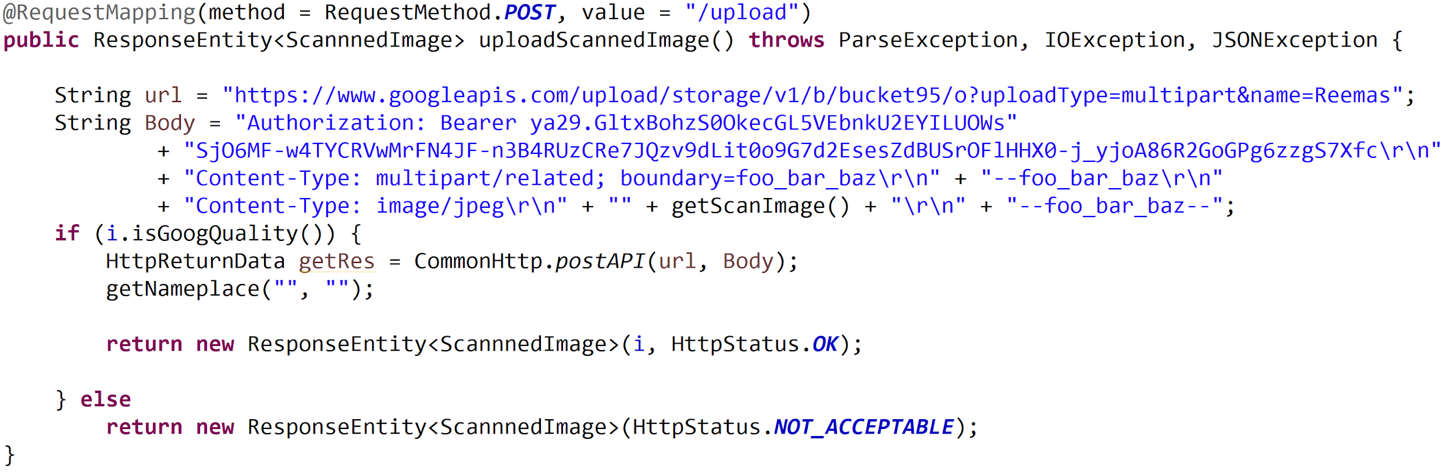
Documentation for API Endpoints

Slide 12




Implementation Details
Technologies used :
swagger
Spring boot
eclipse
Github

Slide 13


Implementation Details
Programming languages involved :
(JDK)java development kit 8
Server :
Apache Tomcat (localhost 8080)

Slide 14

Implementation Details
Deployment Cloud provider :
Google cloud Platform

Slide 15

Screenshots
We tested our API through “Advanced REST client”

Slide 16
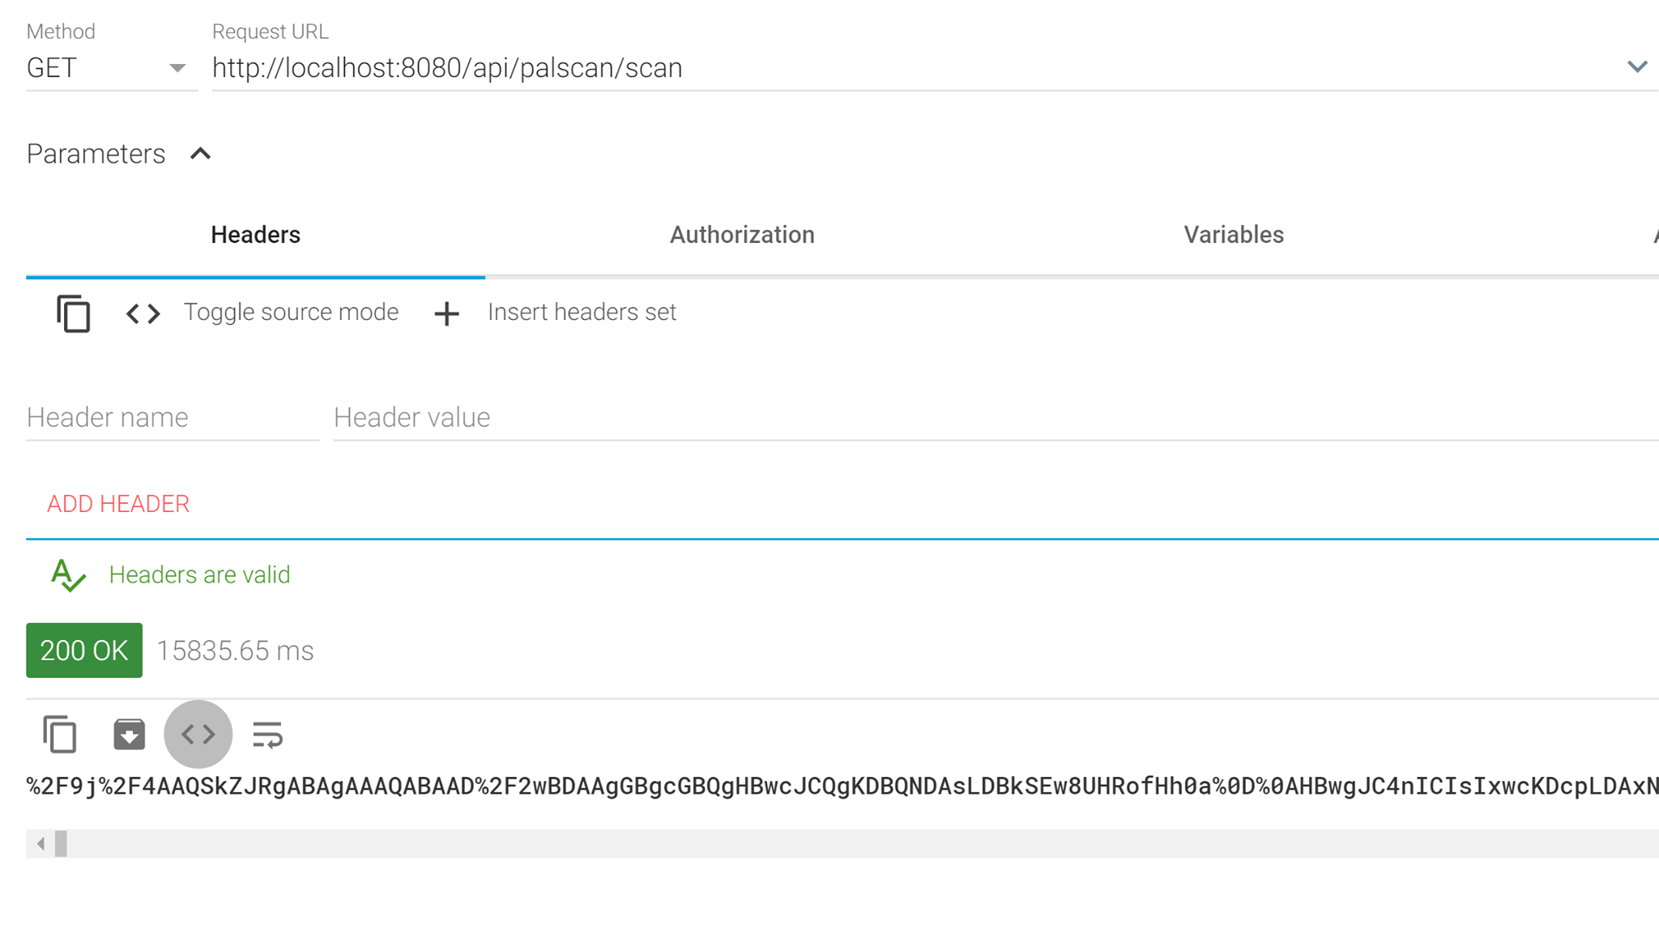
GET palscan/scan

Slide 17
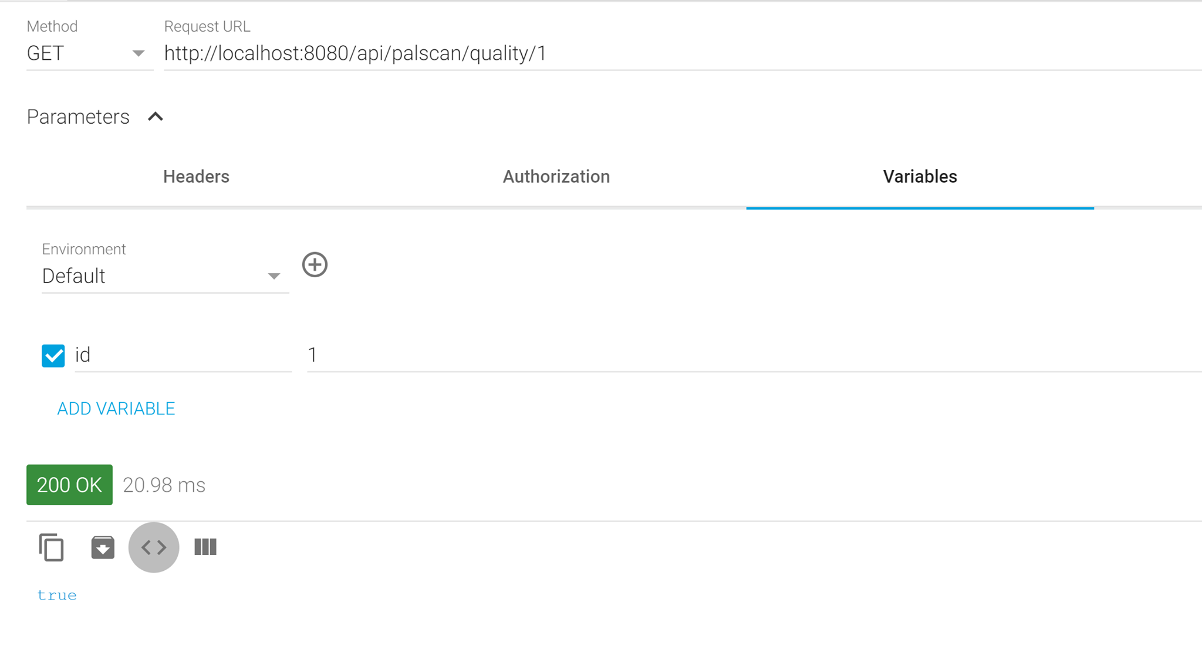
GET palscan /quality/”id”

Slide 18
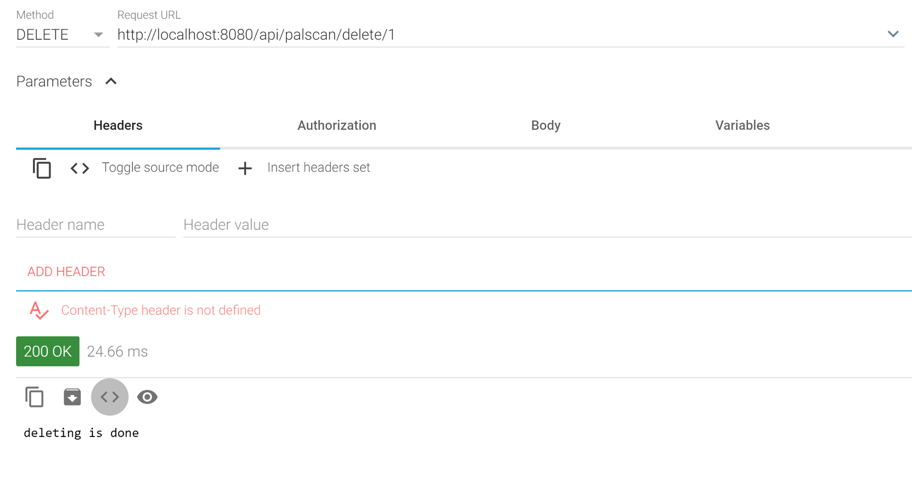
DELETE palscan/delete/”id”

Slide 19
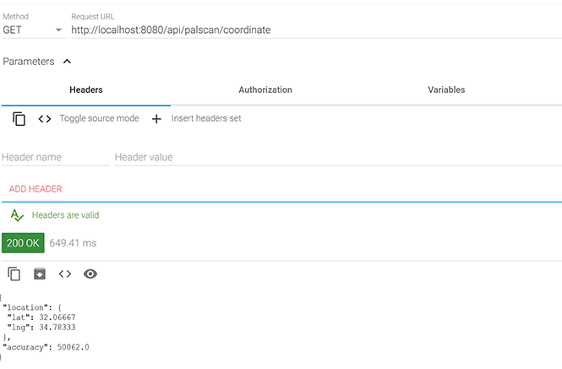
GET palscan/coordinate

Slide 20
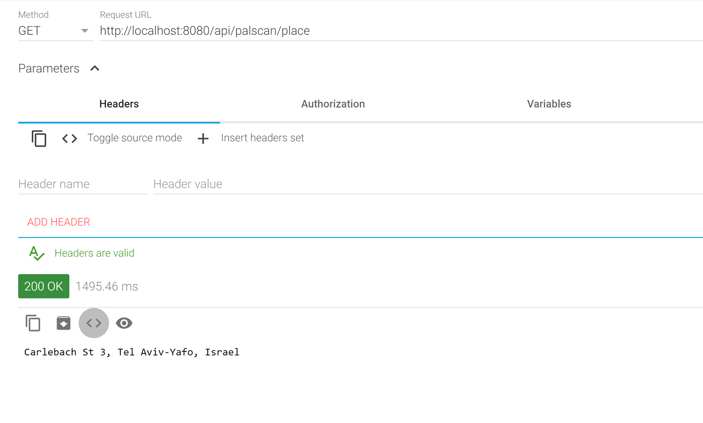
GET palscan/ place

Slide 21
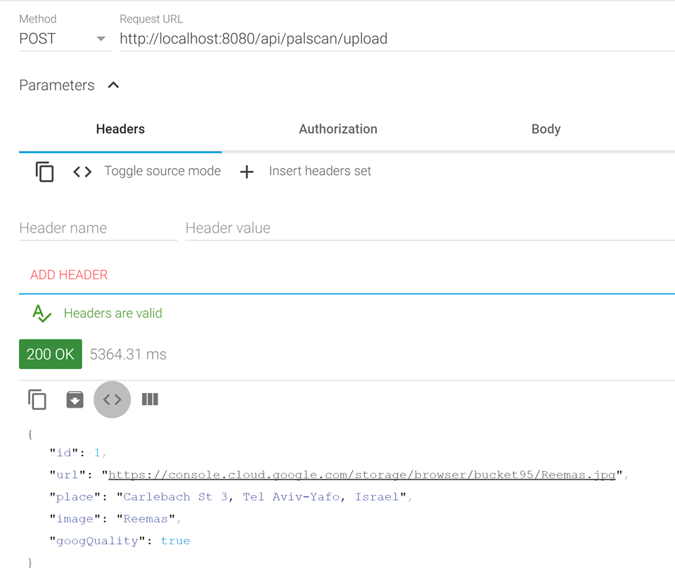
POST palscan/upload

Slide 22
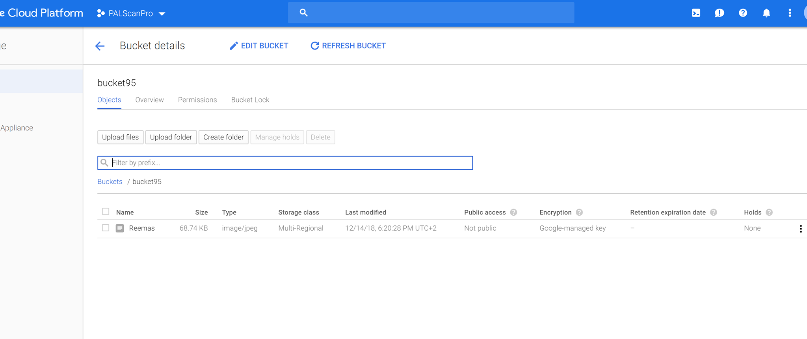
Result

Slide 23


